Slide 1
Marketing, Strategy & Sales
Understand business concepts, processes, or a vision for a solution.

Slide 2
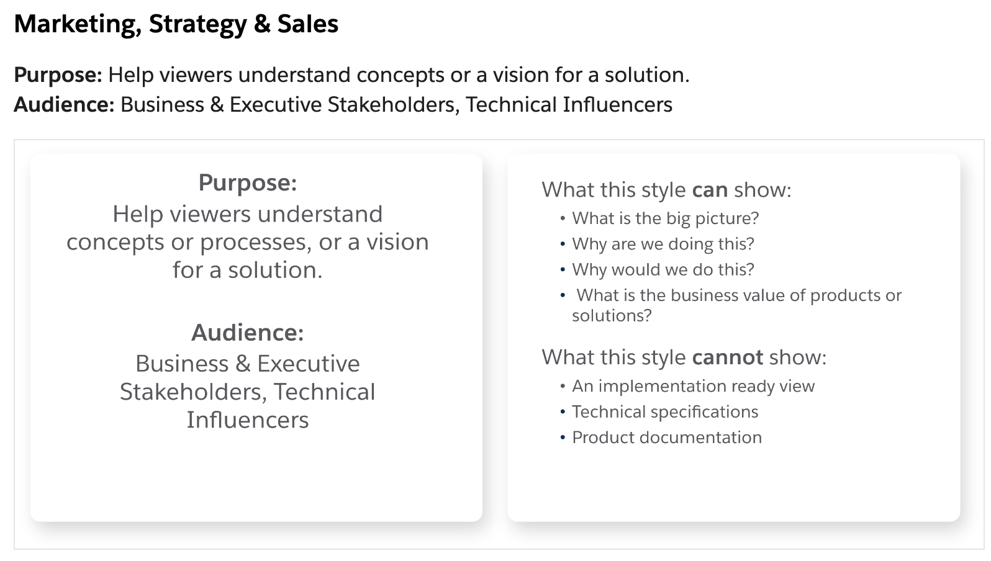

Slide 3
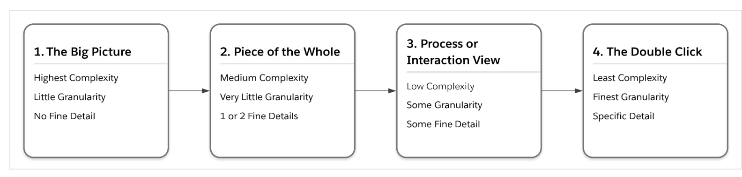

Slide 4

















Your Logo Here
Slack
Sales
Service
Success
Business Capability Map
Marketing
Mulesoft
Learning
Commerce
Platform
Sustainability
This Level 1 Marketing, Strategy, and Sales diagram example details business drivers and capabilities that are a part of a company's transformational vision, and high-level product positioning required to make that vision a reality.
Analytics
Industries
Partners
Business Drivers
Website
Mobile App
Social
SMS
Chat
Email
Meet shoppers where they are
Drive awareness and acquisition
Realize revenue and employee success
Deliver superior customer service
Personalize the customer journey
Commerce
Experience
Sales
Service
Marketing
Site Merchandising
Shopper Experience
Pricing Management
Promotion Management
Order Capture
Order Fulfillment
Self Service
Content Management
Loyalty Management
Lead Management
Onboarding
Training
Cross-Channel Service
Knowledge Management
Predictive Service
Case Management
Returns Management
Order on Behalf
Audience Management
Campaign Management
Journey Management
Marketing Analytics
Privacy Management
Salesforce Customer 360
Content Management
ERP System

Slide 5
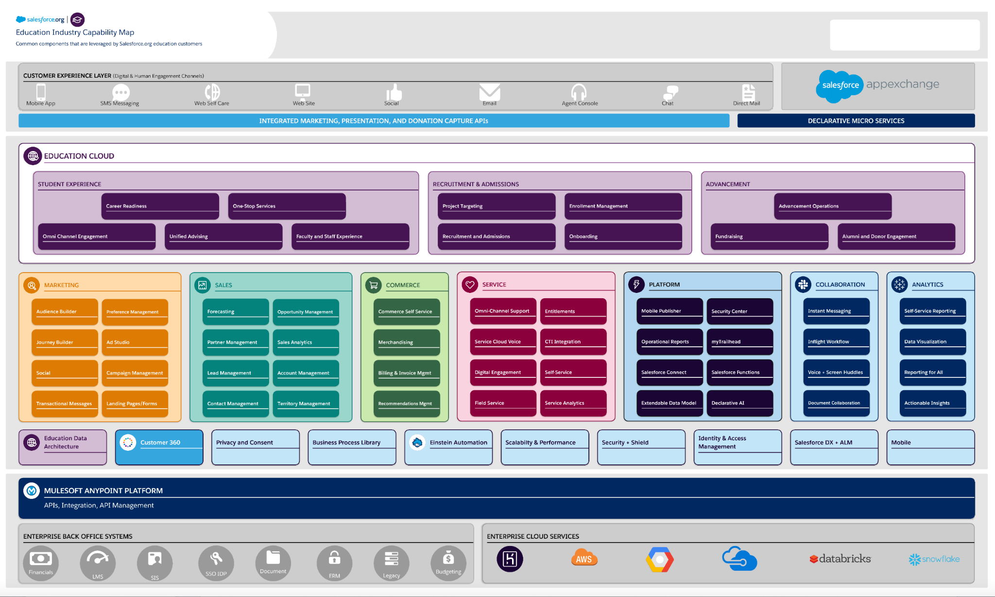

Slide 6












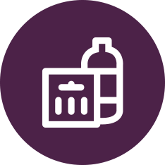










Your Logo Here
Single Source of Truth
Streams
Customer 360 Audiences
Retail Storefront Solution Architecture
This Level 2 Marketing, Strategy, and Sales diagram example details the products and technology directly involved in a retail storefront solution.
Segments
Personalization
Salesforce
Commerce
Marketing
Preferences, clicks, email opens
Orders
Offers
Pricing
Catalog
Experience
Sales
Engagement
Campaigns
Intelligence
Interaction Streams
Affinity & Intent
Order on behalf
Order history
Seamless identity
Profile
Personalization
Self-Service
Accounts, Contacts
Orders
Reports & Dashboards
Distributed Marketing
Personalized Communications
Abandoned cart
Coupon redemption
Personalized marketing
Recommendations
Transactional emails
Service
Customer Data Platform
Social Customer Service
Contacts
Cases
Offers
Tableau
Mulesoft
Industry Data Sources
Supplier & Partner Ecosystem
Content Management
ERP System
Leads, Forecasts, Inventory, POS, etc.
External context

Slide 7







Your Logo Here
Case Management
Computer-Telephony Integration (CTI)
Chat Bot
Order on Behalf Process Flow
This Level 3 Marketing, Strategy, and Sales diagram shows an order on behalf of (OOBO) business process with detail about the timing of the steps and behavior of the flow.
Live Chat
Web Form
Phone
Commerce Cloud
Service Cloud
Website
Mobile App
Customer initiates order request from web shop
CC Storefront
Service Console
2. Agent places order on Customer’s behalf
3. Agent confirms order status with customer
Content Management
ERP System

Slide 8

Your Logo Here
Live Chat
Case Management
User Action
Order on Behalf via Chat Data Flow
This Level 4 Marketing, Strategy, and Sales diagram shows a portion of the overall order on behalf of (OOBO) process with the finest-grain details.
Chat Bot
Automated
Commerce Cloud
Service Cloud
Website
Mobile App
1. Customer uses the 'Chat With Us' feature on the retailer's web shop and requests help with their 'In Progress' order
CC Storefront
2. Bot sends a welcome message and verifies customer identity
Service Console
Chat queue
Chat transcript
3. Order routed via Omni-Channel to next available agent
4. Agent launches shopping cart and completes order
5. Agent confirms order status with customer via chat
Email
6. Customer gets order details by email

Slide 9
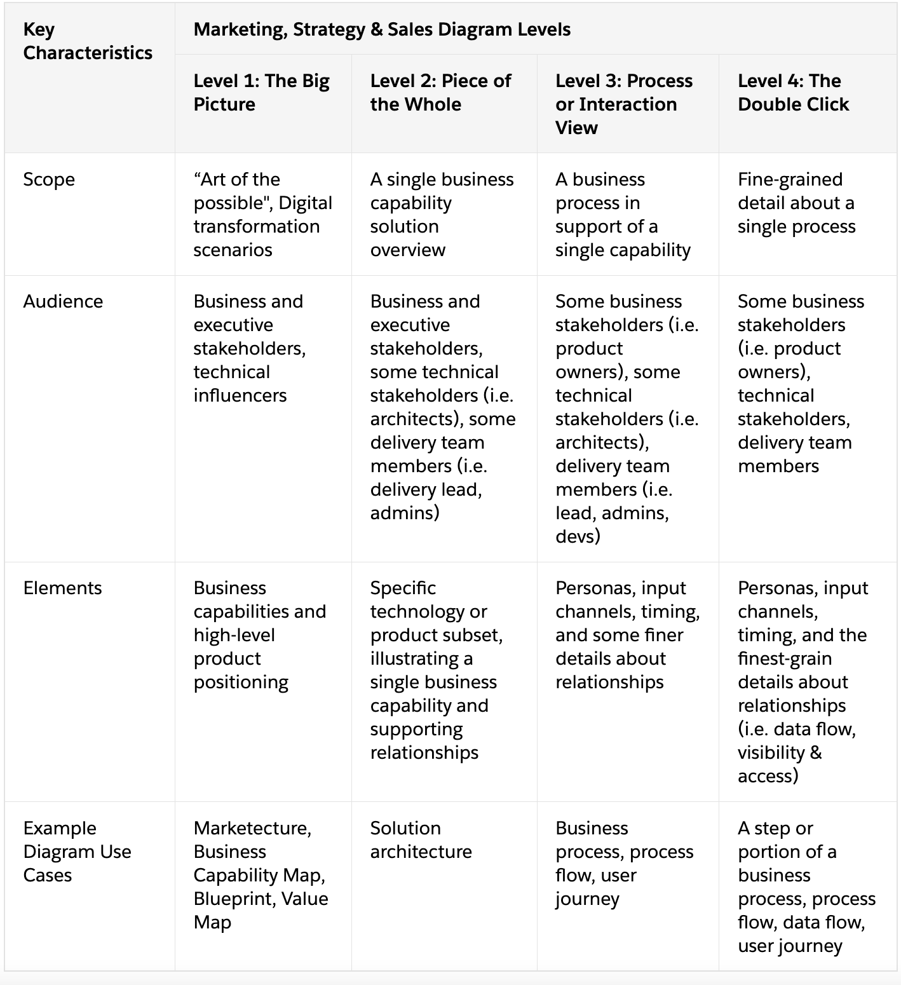

Slide 10
Technical Solution Architecture
Documentation and Implementation Diagrams

Slide 11
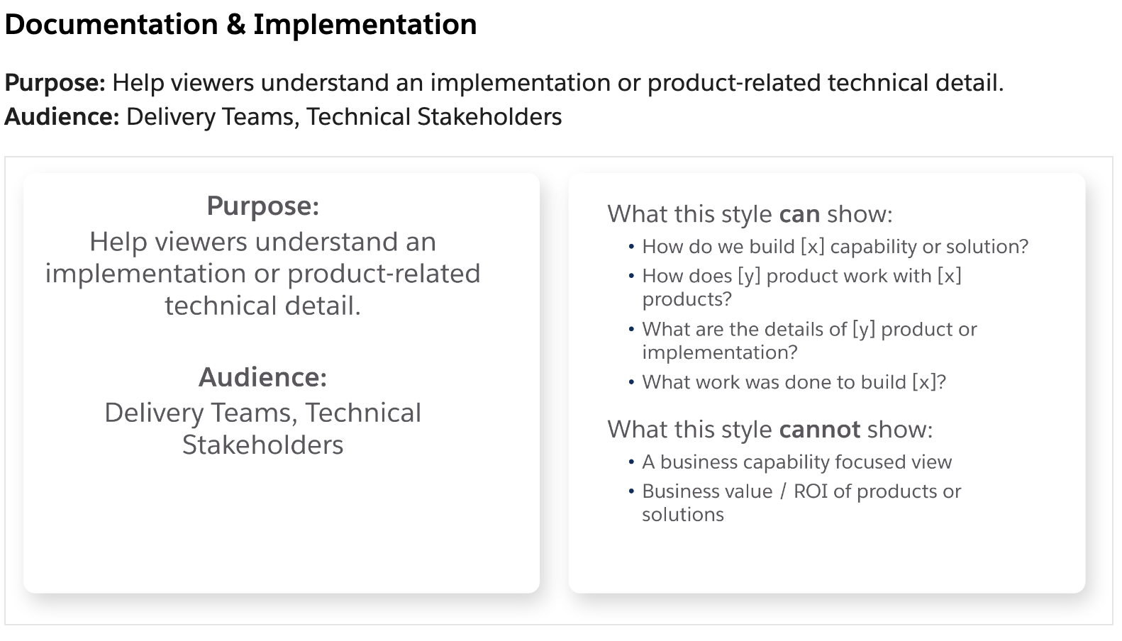

Slide 12









Your Logo Here
Data
Dev
Privacy
LowCode
Orchestration
System Landscape
This Level 1 Documentation and Implementation diagram shows a commerce solution overview indicating the mix of Salesforce products and other technologies involved in an implementation.
AI
Streams
Custom
Bots
Automation
Salesforce
Commerce
Slack
Experience
CDP
Sales
Service
Platform Services
Marketing
Tableau
Mulesoft
External Systems
Content Management
ERP System
Inventory
Finance
Fulfillment

Slide 13

Your Logo Here
Single Source of Truth
Personalization
Privacy
Data
Mobile
Retail Storefront Solution Architecture
Segments
Order Management
Workflow
Low Code
Email
This Level 2 Documentation and Implementation diagram example details the products and technology directly involved in a retail storefront solution.
Streams
Chatbots
AI
Code
Orchestration
Salesforce
Marketing Cloud
Commerce
CC Storefront
Experience
Sales
Engagement
B2C Commerce Connector
OCAPI
Personalization
Marketing Cloud Connect
Service
CDP
Intelligence
Personalized Communications
Tableau
Tableau Connector
Commerce Cloud System API
Salesforce Connector
Salesforce Marketing Cloud Connector
Mulesoft
Anypoint
Composer
Content Management
ERP System

Slide 14



Your Logo Here
Chat Bot
Partner Application
Email
Open Commerce API (OCAPI)
Order on Behalf Solution Architecture
Live Chat
Order Management
Web Form
Interactive Voice Response (IVR)
Voice/SMS
This Level 3 Documentation and Implementation diagram shows the systems and components associated with the order on behalf process flow.
Customer Experience
Service Cloud
Commerce Cloud
Service Console
CC Storefront
Service Cloud Chatbot
Omni-Channel
Authorization
Computer-Telephony Integration (CTI
Channels
Order Confirmation

Slide 15
Your Logo Here
Authorization
Live Chat
User Action
Order on Behalf via Chat Solution Architecture
Chat Bot
Open Commerce API (OCAPI)
Automated
This Level 4 Documentation and Implementation diagram shows the components involved in a portion of the overall order on behalf of (OOBO) process with the finest-grain details.
Contacts
Commerce Cloud
Service Cloud
1. Customer initiates chat request
Chat
Service Console
2. Chatbot Welcome Script
Chat Queue
Chat Logs
3. Customer requests “order on behalf”
4. Chatbot requests information
5. Customer responds + omni-channel routes chat to agent
Omni-Channel
6. OOBO Authorization request for agent via OCAPI
Routing Rules
7. OCAPI response with OOBO authorization verification
8. Agent places order in storefront
9. Confirmation Email Sent
Email

Slide 16
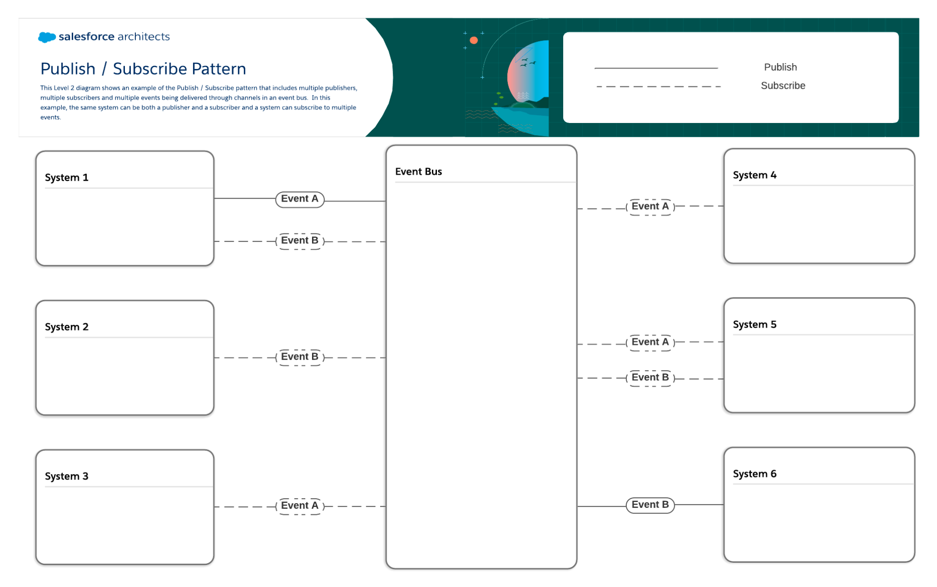

Slide 17
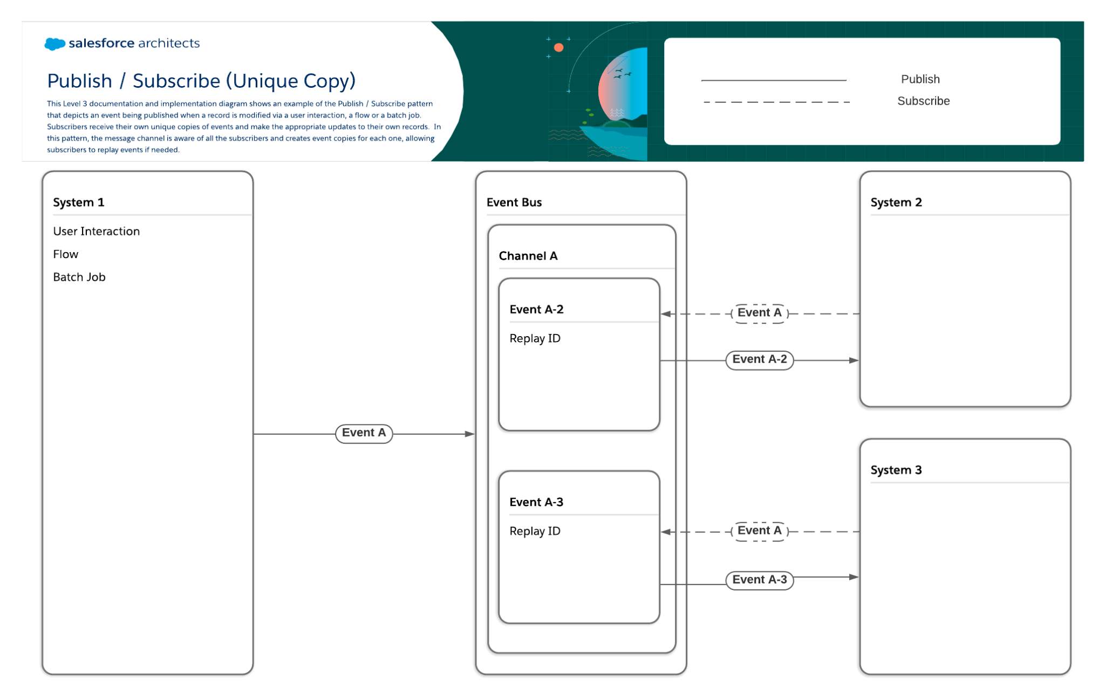

Slide 18
The publish / subscribe (unique copy) pattern
Parallel processing. For resource-intensive jobs involving large volumes of data or heavy CPU usage, you may want to spread the workload out among multiple systems and publish an event that lets every system know when it is time to start processing.
Chat / messaging. Enabling users to send text, images, and files to a group of other users through a messaging platform is a common publish / subscribe (unique copy) use case.
Asynchronous processing. As the use of IoT sensors continues to rise, use of the publish / subscribe (unique copy) pattern will continue to rise with it. When a sensor detects an issue, the system monitoring it can publish a message that can be picked up by one or more case management or workforce scheduling systems for further processing.

Slide 19
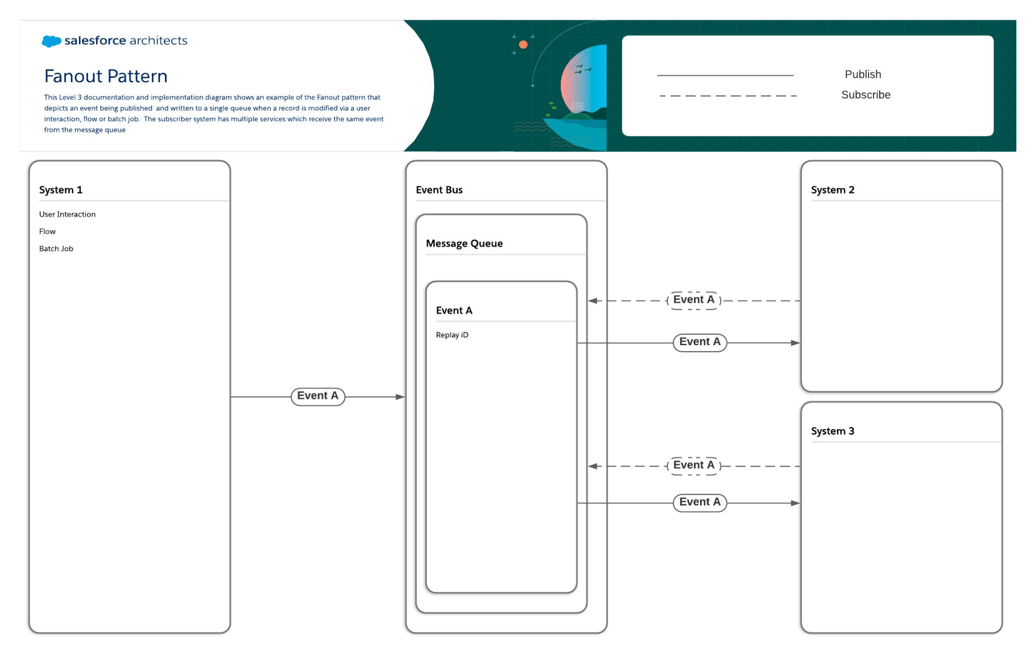
Notifications (Mobile/SMS)

Slide 20
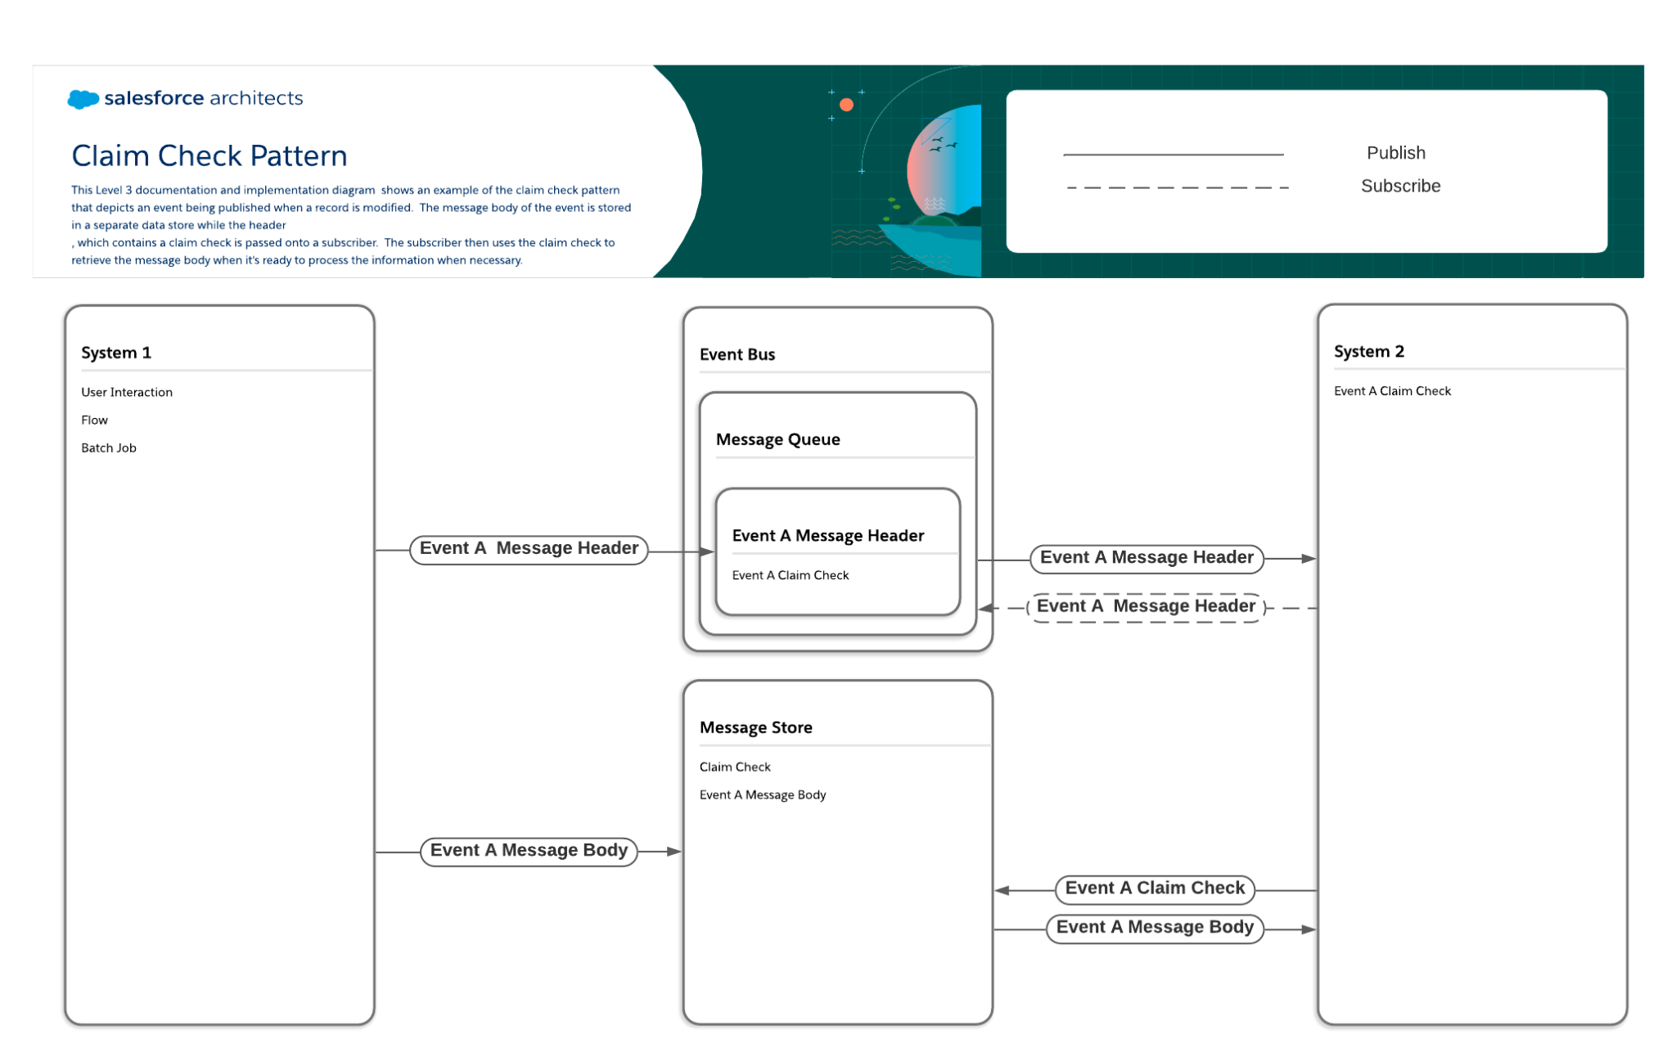

Slide 21
Claim Check Pattern
Business Use Case Examples
Large volumes of messages. Because the claim check pattern reduces the size of delivered messages to just the header information, messages can be processed more quickly and efficiently. This is helpful for integrations involving medical devices that collect and send data at short intervals, such as heart rate monitors, and also for retail or similar consumer facing organizations that have to send and receive large numbers of messages. (See Well-Architected - Throughput Optimization for more information.)
Need for longer message retention. Because messages are sent to their own data store, they can be retained longer than the standard retention times of event buses. This is helpful for organizations that have regulatory mandates that require messages to be stored for a longer period of time. It also helps lower the likelihood of data loss since messages will still be accessible from the message store even if the original delivery attempt fails.
Message size reduction for legacy applications. When an organization relies on legacy applications that have limitations on the size of messages they’re able to process, this pattern can help with integrations since it keeps message sizes to a minimum by nature.

Slide 22
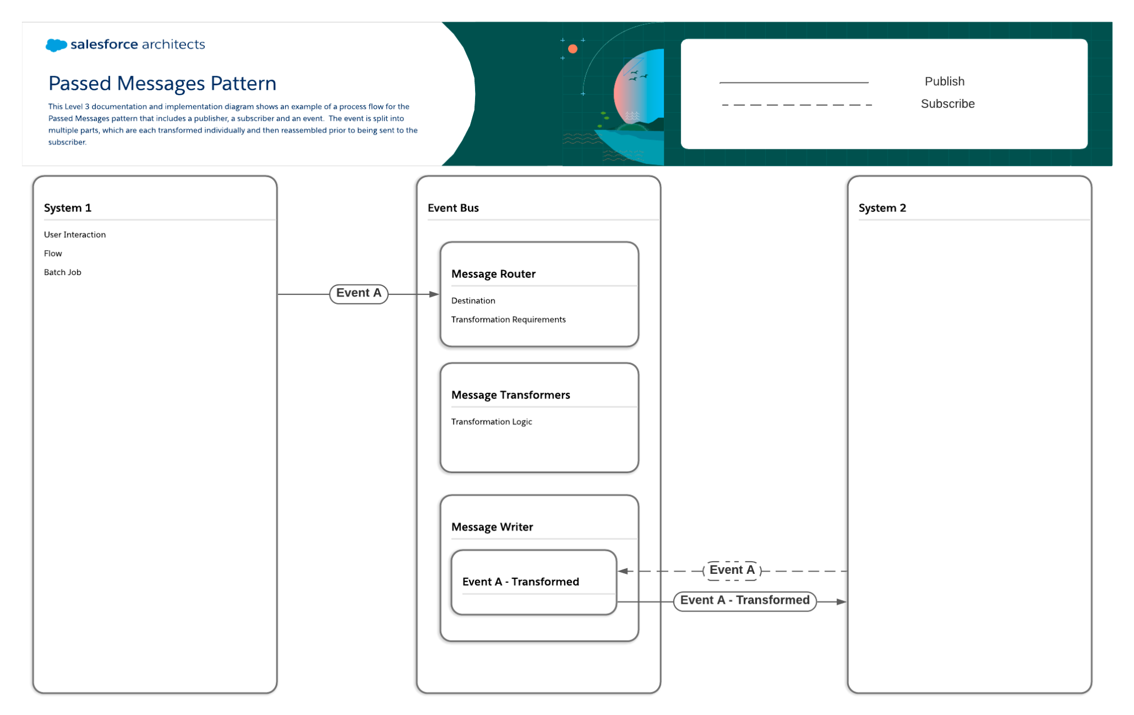

Slide 23
Passed Messages Pattern
Business Use Case Examples
Seasonal volume spikes. The passed messages pattern can address issues such as spikes in volume that online retailers that sell seasonal items often see when their items are “in season”. When large numbers of customers are making purchases at the same time, the number of events that get generated can temporarily exceed the capacity of synchronization and transformation processes. (See Well-Architected - Transaction Handling for more information.)
Case or claims management. This pattern can be useful for utility companies that can experience surges in number of cases or claims during outages.
Complex data transformations. The passed messages pattern can also be applied when organizations require complex logic to transform messages and are concerned about events being generated faster than they can be transformed.

Slide 24


Slide 25


Slide 26
Queuing Pattern
Business Use Case Examples
Low quality internet connections. Field service organizations or other organizations where teams with mobile devices need to work in areas with low quality or intermittent internet access will benefit from queuing since the applications on these devices can connect to their queues and retrieve any relevant messages when connectivity is restored.
Message buffering. For organizations that occasionally experience surges where the volume of messages being produced exceeds the subscribers’ ability to process them and where longer time periods between messages being published and received won’t create additional issues, queues can be used as buffers to store excess messages and prevent data loss.
Transportation management. Logistics organizations that need to monitor their fleets can use this pattern to view the routes that each vehicle is taking in near real time and ensure that drivers are being as efficient as possible.
IoT devices. Manufacturers often use systems that generate rapid streams of data, and these streams can have downstream effects on additional systems. This pattern can be used to identify sequences of events that require human intervention before catastrophic failures spanning multiple systems occur.

Slide 27
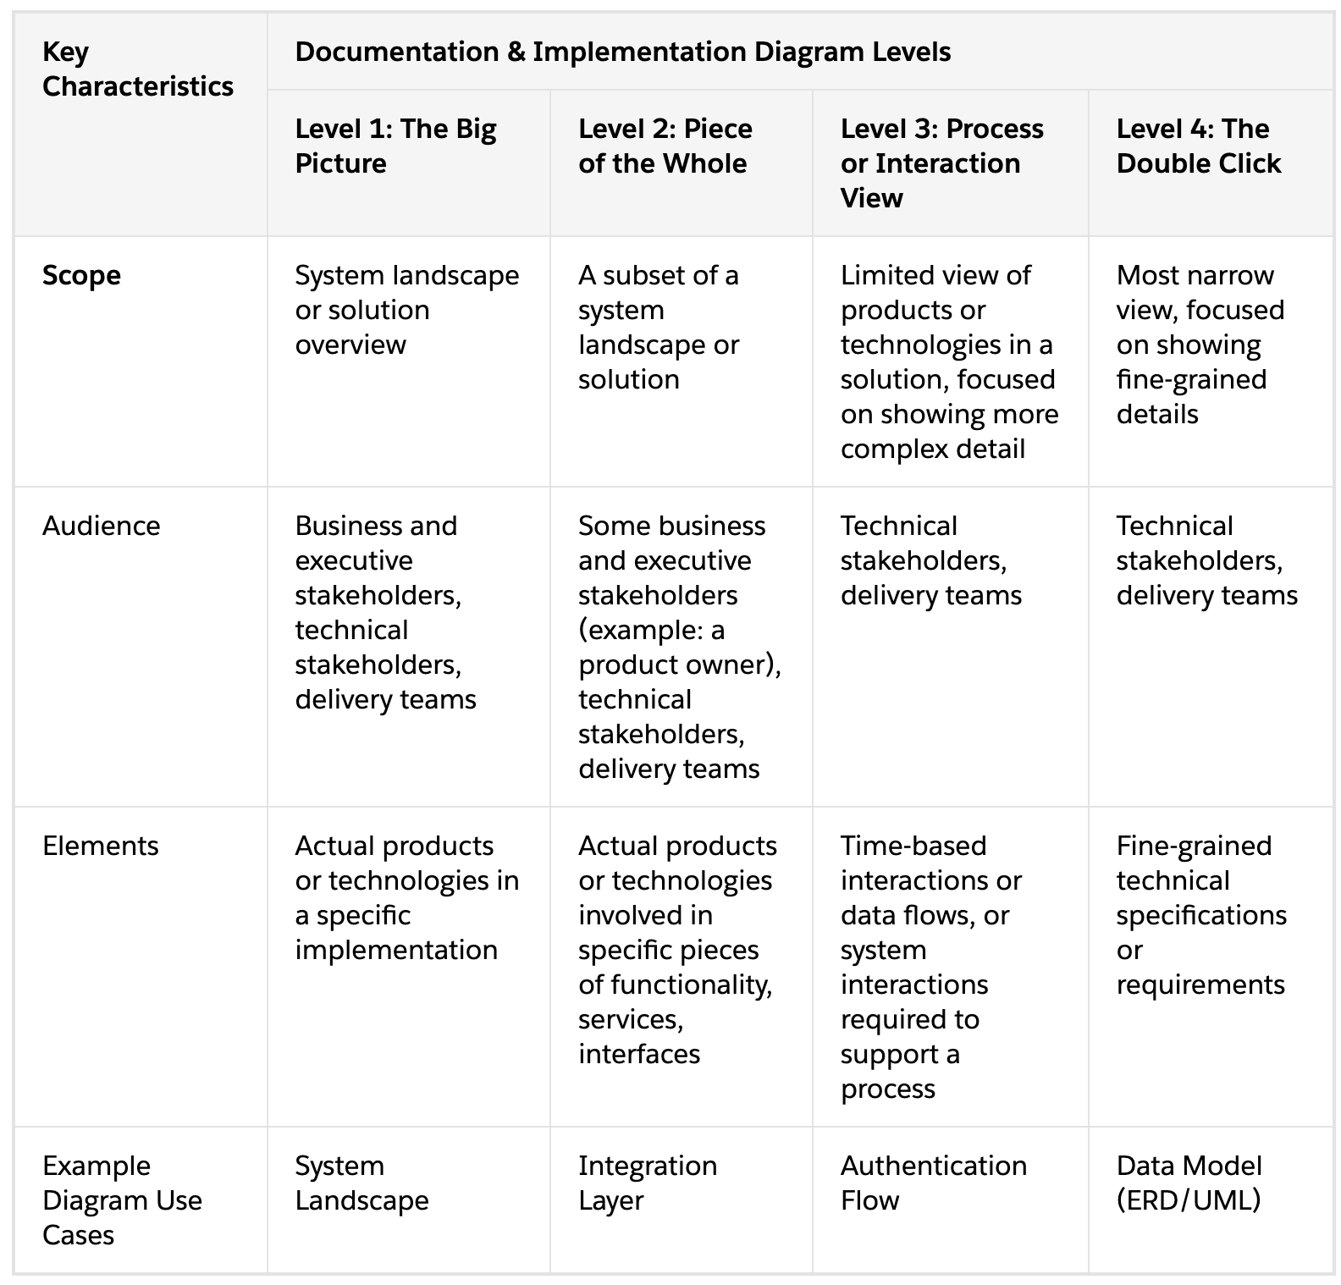

Slide 28
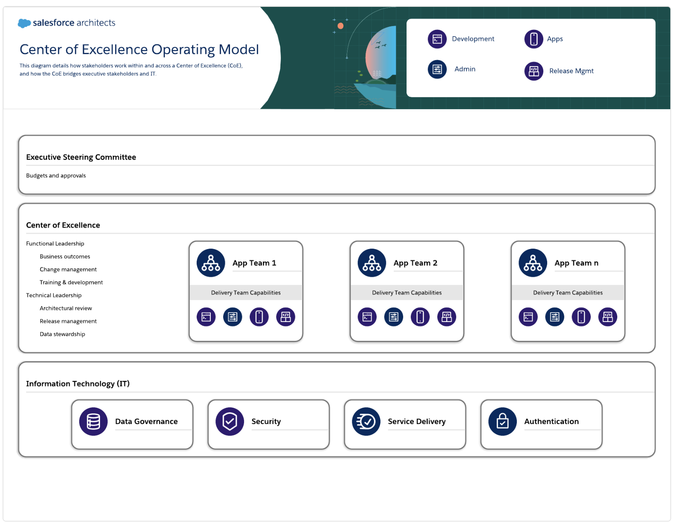

Slide 29
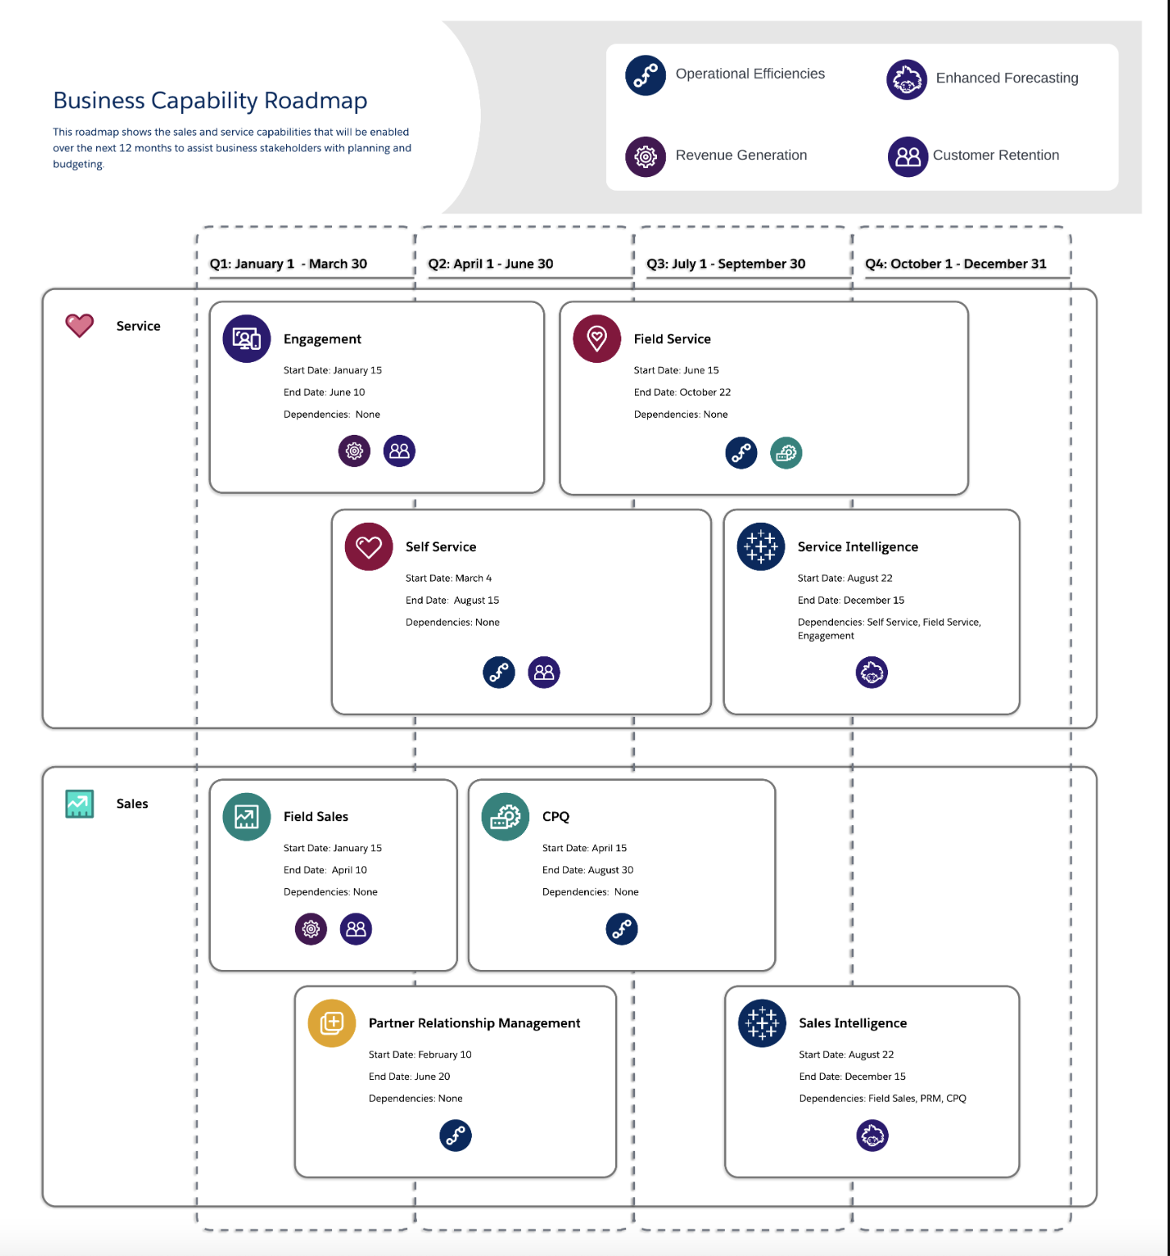
https://architect.salesforce.com/1/asset/immutable/s/d0dd989/assets/images/roadmap-business-capability.png

Slide 30
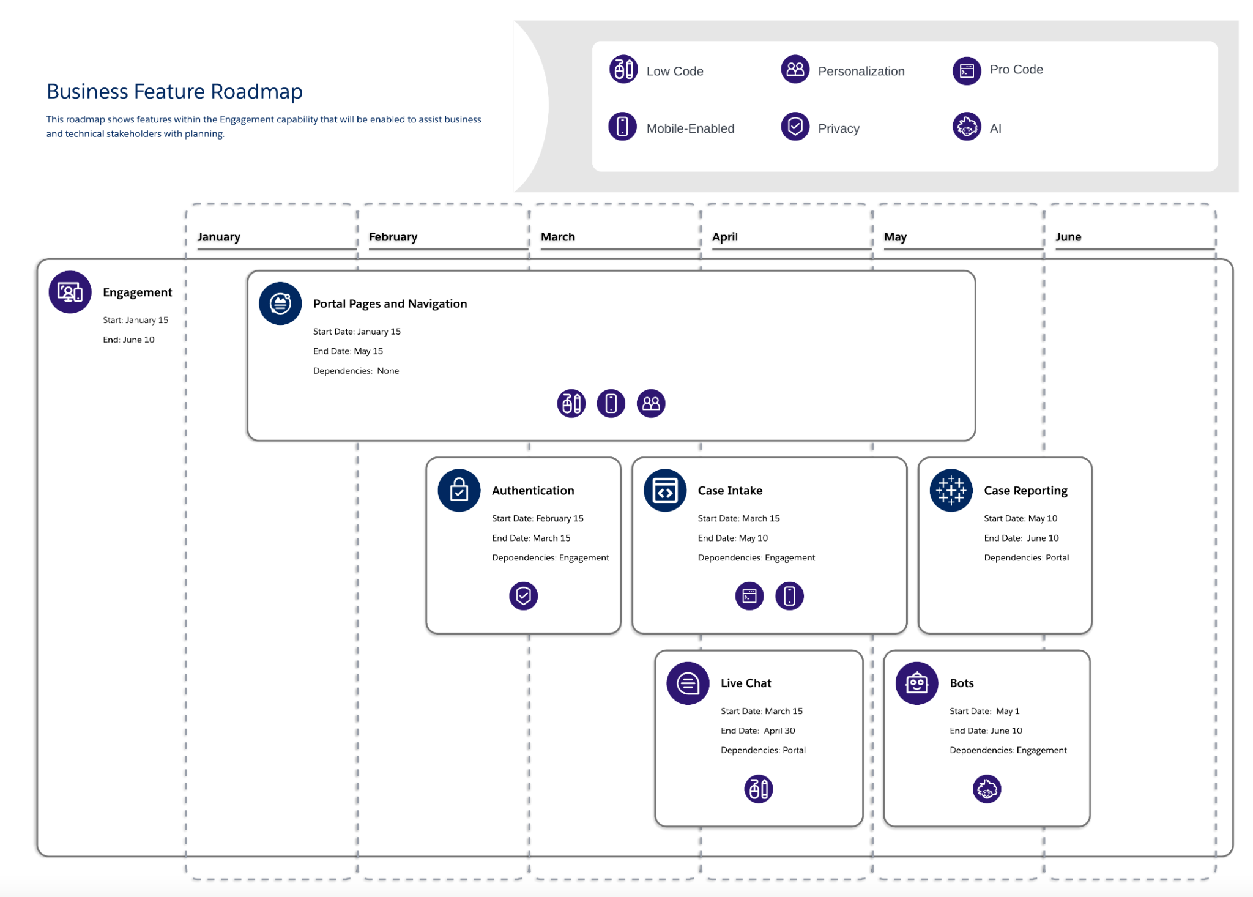
https://architect.salesforce.com/roadmaps/roadmap-explorer
https://architect.salesforce.com/1/asset/immutable/s/e10259c/assets/images/roadmap-business-feature.png

Slide 31
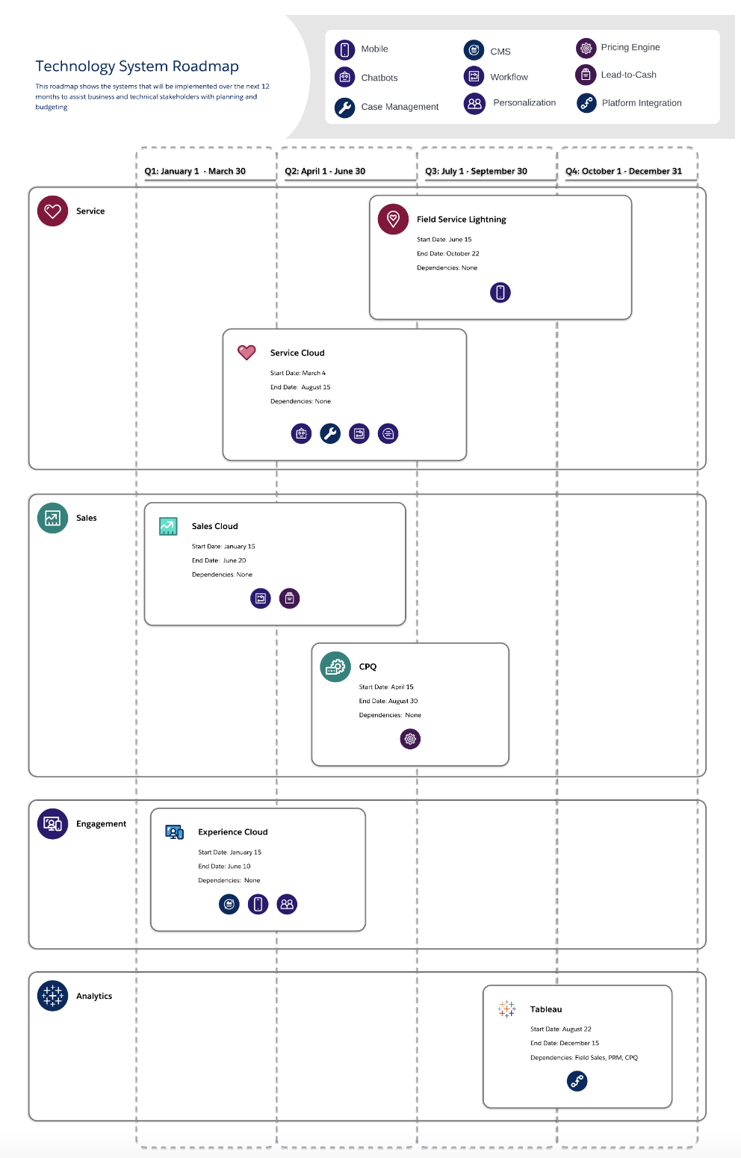

Slide 32
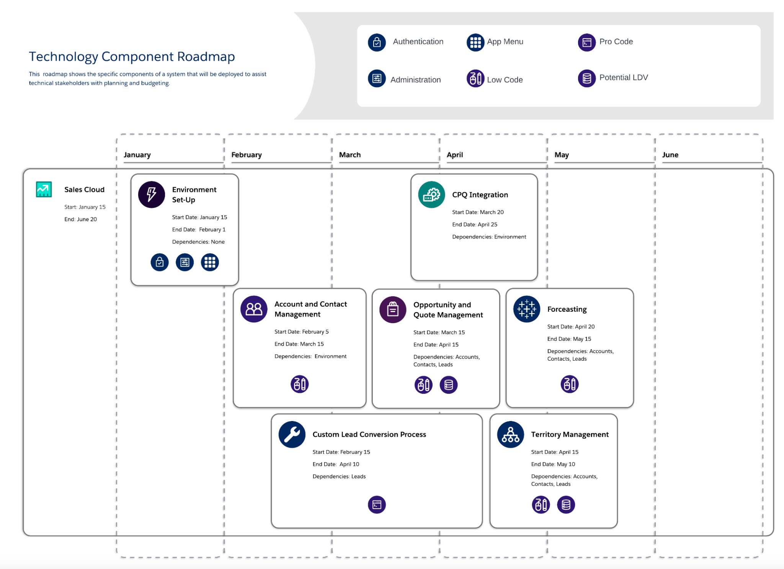
https://architect.salesforce.com/1/asset/immutable/s/03feb82/assets/images/roadmap-technology-component.png

